Slide 1

Recognizing the Needs of Older Adults with Combined Vision and Hearing Loss
Presented at the National Council on Aging (NCOA) Conference on May 8th, 2024
Jenee Alleman, M.A.
Older Adults Specialist
Tara Brown-Ogilvie, M.S.Ed., COMS, ABD
Research and Accessibility Specialist

Slide 2

What is the Issue?
  Main Issue
    The rise of acquired Dual Sensory Loss (DSL) in the aging population.
  Key Cause:
    Age is the most common factor contributing to acquired hearing and vision loss.
    According to the 2022 American Community Survey (ACS), approximately 80% of persons over the age of 55 report some form of combined hearing and vision loss.
  Current Trends:
    With the global population aging, there's an increasing need to adapt services.
  Call to Action:
    Tailoring services to meet the unique needs of older individuals with DSL.

Slide 3
Terminology
Various terms can be used to describe the spectrum of Combined Vision and Hearing loss*
Dual Sensory Loss (DSL)
Dual Sensory Impairment (DSI)
DeafBlind (DB)
Blind / Hard of Hearing, Deaf / Low Vision, etc..

Slide 4
Helen Keller National Center (HKNC)
HKNC's Mission
  A federal agency dedicated to serving persons with dual sensory loss nationwide. Older Adult Programming for adults (55+).
Strategic Approaches
  Data-Driven Development: Identifying and addressing data gaps to enhance our programs.
Proactive Surveying Conducted a nationwide survey to better understand and meet the needs of our community.

Slide 5
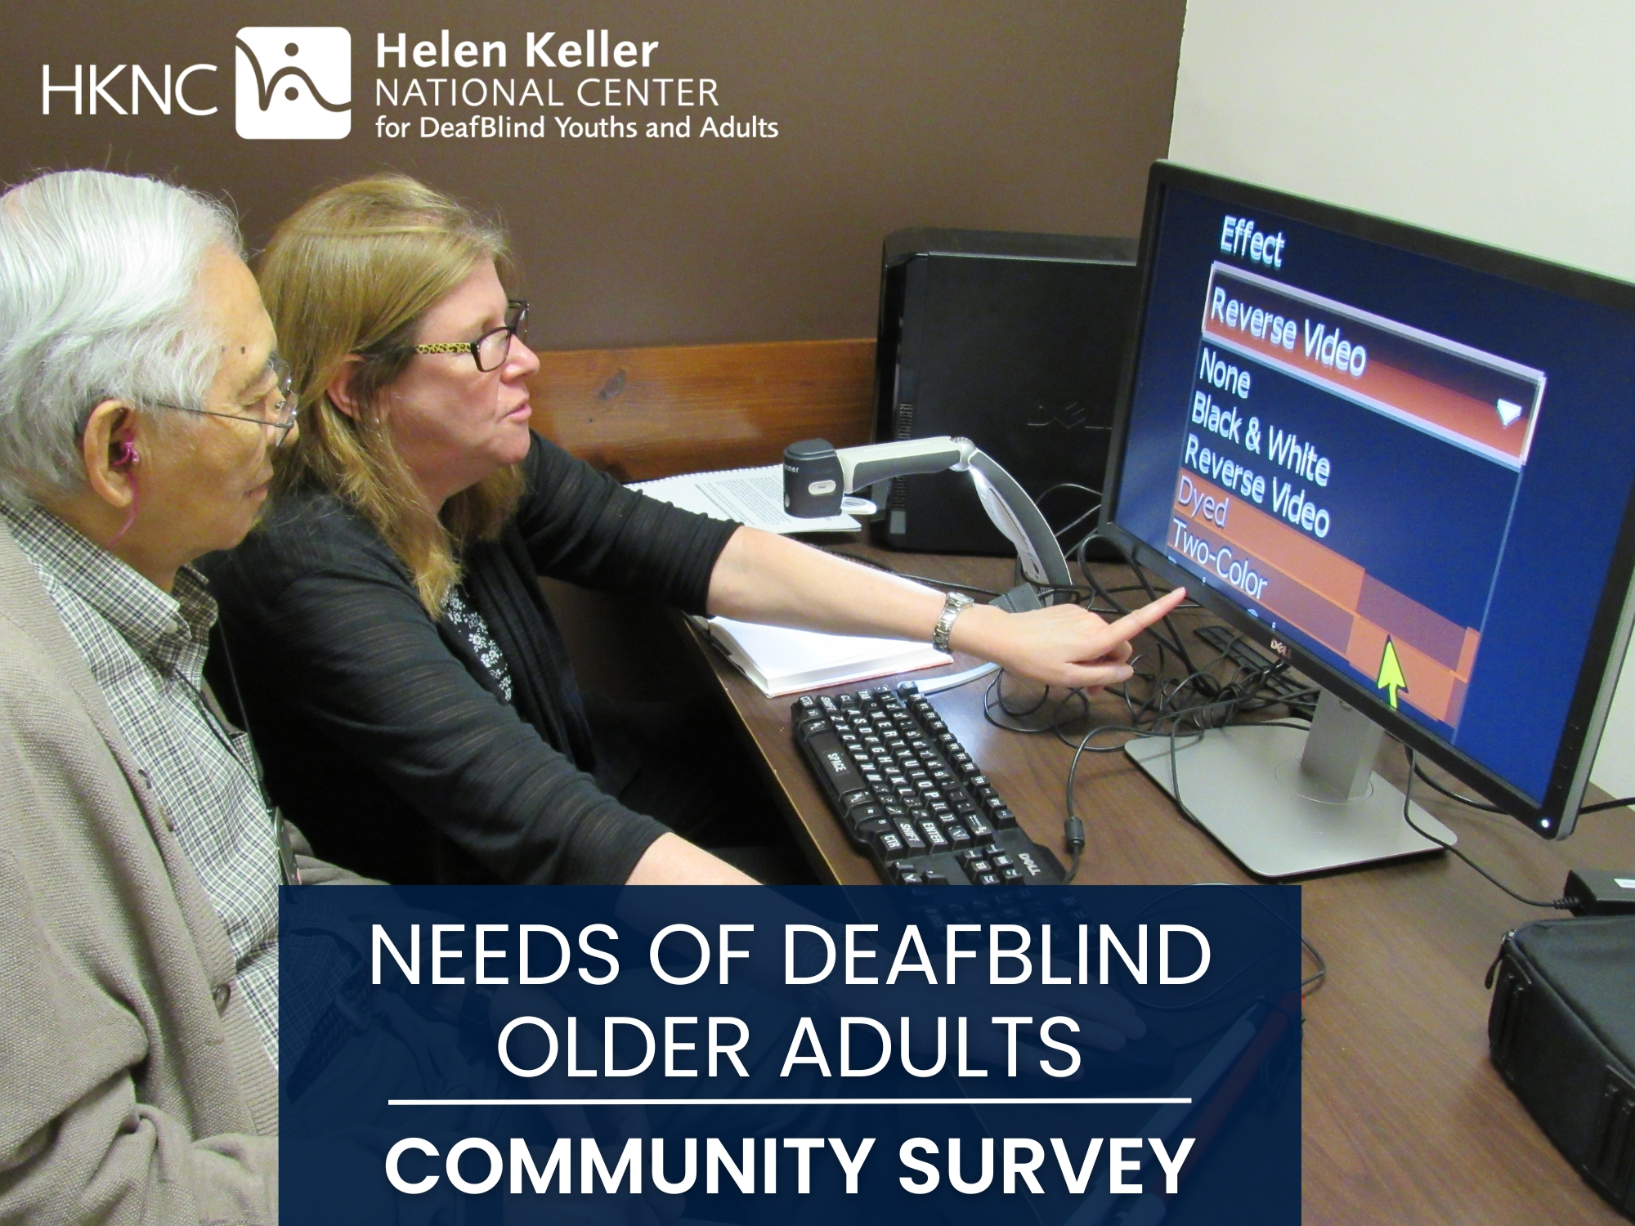
HKNC Community Input Survey
We received 334 survey responses.
Generally, ages 55 to 75 (80%) with some older than 76 (20%).
With representation of 45 states, 3 territories, & the Bahamas.
  Puerto Rico, Guam, and America Samoa.
Notes:
3 territories = Puerto Rico, Guam, and America Samoa Islands

Slide 6
Combined Hearing & Vision Loss
Deaf / Hard of Hearing:
  Hard of Hearing (Mild to Moderate) ~ 36%
  Moderate to Severe Hearing loss ~ 30%
  Profoundly Deaf ~ 25%
  Other (many write ins) ~ 9%
Vision: Most participants reported being legally blind (52%), totally blind (22%), and low vision (25%).

Slide 7
Communication
Speech was most common (61%)
Then visual, tactile, or close vision ASL (45%)
With some reporting a mixture of ASL and Speech.
Others explained they used also texting, email, video relay services, and writing back and forth to communicate as well.

Slide 8
Key Findings – Areas of Need
Top 5 identified areas of need for DeafBlind older adults.
  Need for Support Service Provider / CoNavigator (SSP/CN) Services
  Reliable Transportation
  Support with Isolation and Well-Being
  Communication Access
  Training for Support Staff & Medical Professionals
Notes:
C/N = Co-Navigator

Slide 9
Key Findings – Need for SSP/CNs
DeafBlind Older Adults expressed a great need for Support Service Provider / Co-Navigator Services.
  An SSP/CN is similar to a Personal Care Attendant (PCA), but with training specific to dual sensory loss and the ability to drive clients
  29% reported currently receiving SSP / CN services.
  Some that were not familiar with the term SSP/CN wrote in the need for a private driver, help in setting up and going to doctor’s appointments, and assistance with everyday tasks such as grocery shopping, reading mail, etc.

Slide 10
Key Findings – Need for SSP/CNs Cont.
DeafBlind Older Adults expressed a great need for Support Service Provider / Co-Navigator Services.
  67% reported difficulty with grocery shopping.
  65% needed assistance with traveling independently.
  Others commented that they rely on a spouse, family, member, etc., but wish they had a separate support person.

Slide 11
Key Findings – Need for Reliable Transportation
DeafBlind Older Adults reported a lack of reliable transportation.
  ~33% of participants said lack of transportation was a barrier to them receiving services.
  ~35% said people not being able to travel with them was a service barrier as well.
Quote: “I am totally isolated from participating with the deaf or the deaf/blind because of the distance and my inability to use public transport.”

Slide 12
Key Findings – Isolation & Well-Being
DeafBlind Older Adults expressed varying levels of isolation.
~32% of participants said, “Yes, I often feel isolated.”
~47% of participants said, “Sometimes, I feel isolated.”
~21% of participants said, “No, I don’t feel isolated” with some write-ins.
Quote: “With no family to help, I wish there was support for those of us DB who are alone. Can be hard to find trusted help. Also wish there was timely support when the unexpected happens. Can be scary.”

Slide 13
Key Findings – Communication Barriers
DeafBlind Older Adults shared struggles in communicating with staff and medical professionals.
  ~25% of participants report sufficient access to qualified ASL interpreters.
  ~33% of participants reported limited access to qualified ASL interpreters.
  ~17% answered N/A with some write-ins.
Quote: “Doctors and nurses are still refusing to provide interpreters here even when serious health problems exist..”

Slide 14
Key Findings – Need for Staff Training
DeafBlind Older Adults stated that staff and medical professionals could benefit from training.
  ~25% stated that staff did not understand Deafblindness.
  ~12% state that staff could not communicate with them directly.
Quote: “Staff training is very much needed to learn how to assist DB people of all ages, especially DB seniors, and for each stage of vision loss. We need to be treated as individuals, not as clients.”

Slide 15
Additional Considerations
Expressed need for better / more frequent access to the following training areas:
  Mobility
    Public transit, getting around independently, etc.
  Assistive Technology
    iPhones, iPads, PC, Braille Displays, etc.
  *Independent Living (IL) also mentioned, but not as much as O&M and AT.
Notes:
Also

Slide 16
Unique Challenges of DSL
  No longer able to read lips.
  Balance issues and feeling dizzy due to hearing and/or vision loss.
  Using a video phone with limited vision to see ASL / sign language.
  Needing training with assistive technology such as a screenreader that can read emails.
  Traveling independently as a person with dual sensory loss (need O&M training).
  Lack of ASL interpreting services.
Notes:
Also

Slide 17
Common Challenges of Aging
  Hard to read small / fine print.
  Not able to drive anymore.
  Struggle with technology (e.g., iPhone, Computer, etc.).
  Fine motor skills (inserting a key into a lock).
  Feelings of isolation.
  Need help with grocery shopping, traveling to doctors’ appointments, etc.
Notes:
Also

Slide 18
How can we work together?
We are open to ideas on how to better support older adults (55+) with DSL, please contact us if you would like to collaborate!
HKNC can partner with local, state, and national organizations who serve individuals with combined vision and hearing loss. This can include nursing homes, VR, senior centers, and more.
HKNC can also provide staff trainings, online modules, and workshops on DSL and mobility, technology, communication, etc.
Contact Jenee Alleman jalleman@helenkeller.org Older Adult Specialist

Slide 19

This has been a Presentation by the
Helen Keller National Center
This power point is the property of HKNC
Please do not copy, distribute or reuse.
Contact HKNC for more information at:
pld@hknc.org

